Slide 1
Developing a Booking Prediction Model for a Hotel
This presentation discusses the development of a model to predict whether a client will cancel or honor their booking at a hotel in Kampala, in order to minimize losses caused by canceled bookings. And to maximise profits from targeted promotions and campaigns.

Slide 2

Problem Statement
The hotel receives calls and website bookings for rooms.
Majority of clients do not make deposits, leading to many canceled bookings.
This has resulted in significant losses for the hotel.

Slide 3

Data Collection
The hotel records data on each booking, including booking ID, number of guests, length of stay, meal plan, parking needs, room type, lead time, arrival date, market segment, price, and booking history.
This data is what we used to train a model to predict future booking outcomes.

Slide 4
Model Development
Using the collected data, a machine learning model was developed to predict whether a booking is likely to be honored or canceled.
The model considers various factors such as market segment, lead time, and booking history to make predictions.
The model has been trained on historical data and can be used to make predictions on new data.

Slide 5
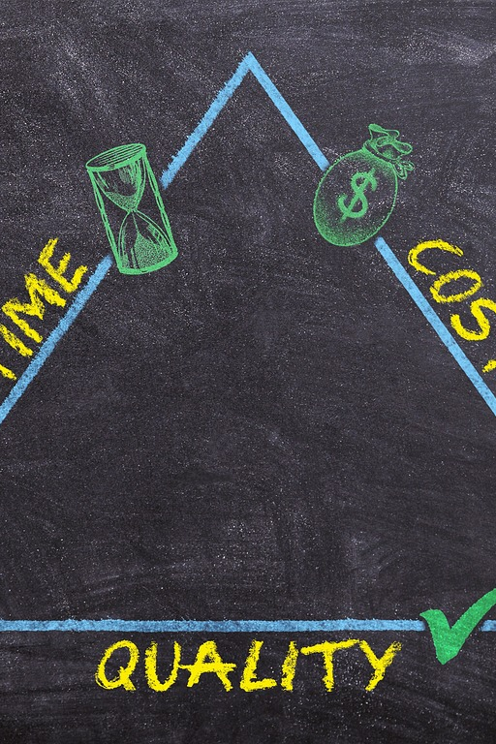
Benefits of Booking Prediction Model
Implementation of the booking prediction model can significantly reduce losses caused by canceled bookings.
The hotel can optimize staffing, food and beverage production, and room allocation based on predictions and expected arrivals.
The hotel can also carry out targeted campaigns and promotions as a marketing strategy using model predictions

Slide 6
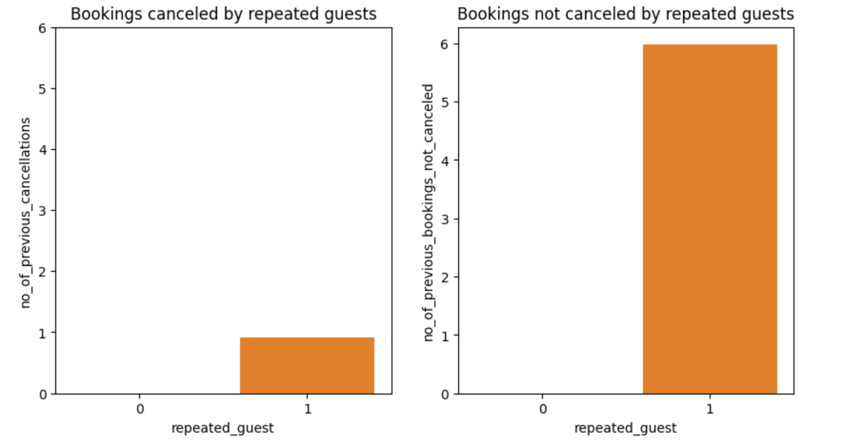
Insights from the existing data
From the data collected, we observed that a repeated client is most likely to honor their booking.

Slide 7
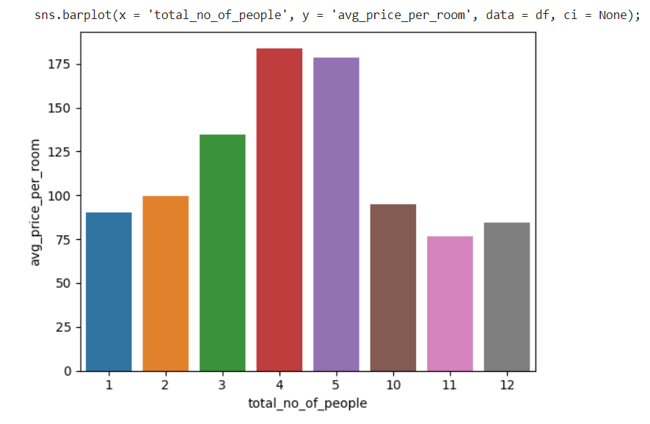
Relationship between number of people and room price
The price of the room is highly affected by the number of people. The trend is that when the number exceeds 4, the price starts to go down means that usually group bookings opt for the cheaper rooms.

Slide 8

Impact of wong model predictions on the hotel
Some clients may be predicted to cancel but actually will not, resulting in the hotel not being prepared for their arrival.
The hotel will have to deal with a frustrated client.
And the client may be lost like that.
However, this rate is low and can be balanced out by the bookings that have not been honored.

Slide 9
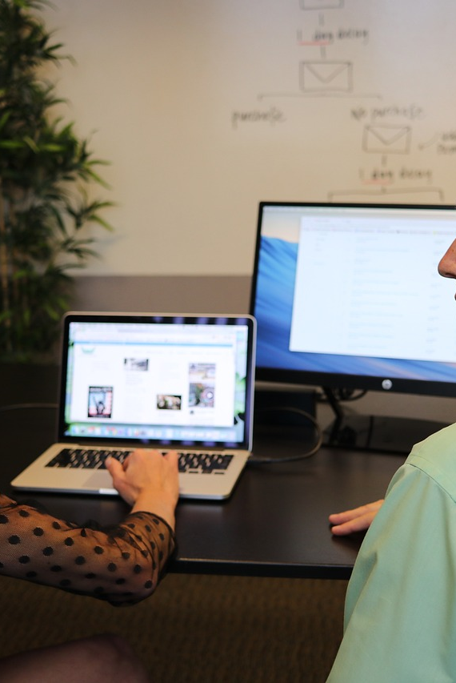
There is hope!
There are fewer cancellations than confirmed bookings.
This means that false negatives are less impactful than false positives.
The recommended model has a low false positive rate of 0.05%.

Slide 10
Thank you. Please feel free to ask any questions. 😄

